Slide 1
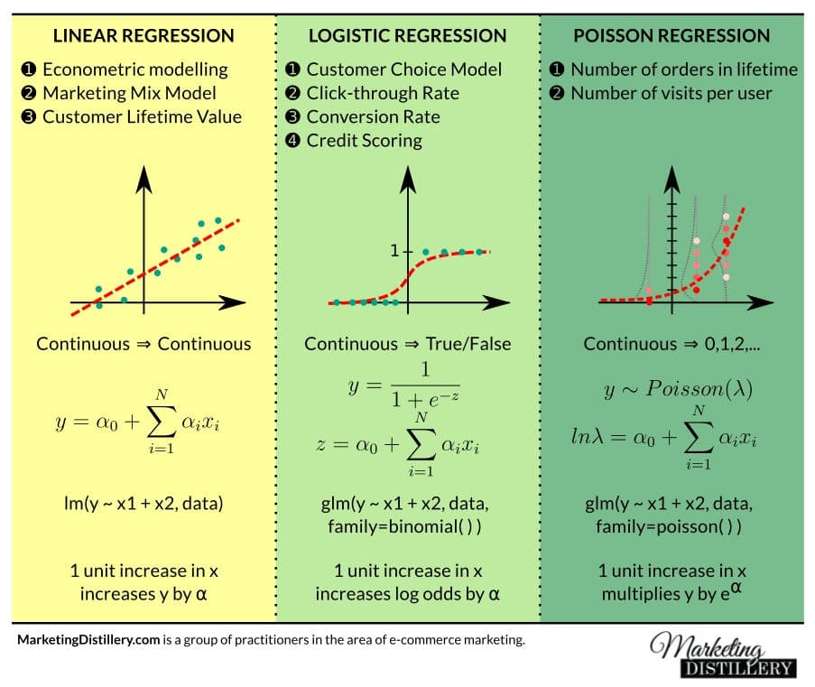
Advanced Regression Concepts
Bending the Rules and Taming the Algorithm
Instructor: Zaryab Ahmad Khan

Slide 2
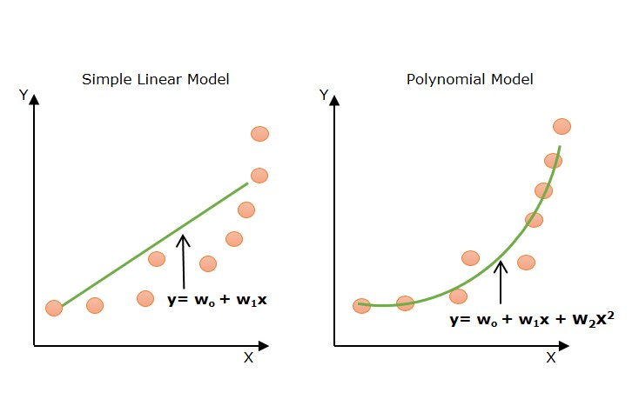
Polynomial Regression (Bending the Line)
The Problem: Standard Linear Regression assumes data moves in a straight, predictable line. Real-world data (like viral spread, compound interest, or engine heat) often curves.
The Solution: Polynomial Regression. We add "curves" to our math equation.
Concept: Instead of just predicting based on X, we allow the model to learn from X^2 or X^3, letting the line of best fit physically bend to follow the data points.

Slide 3
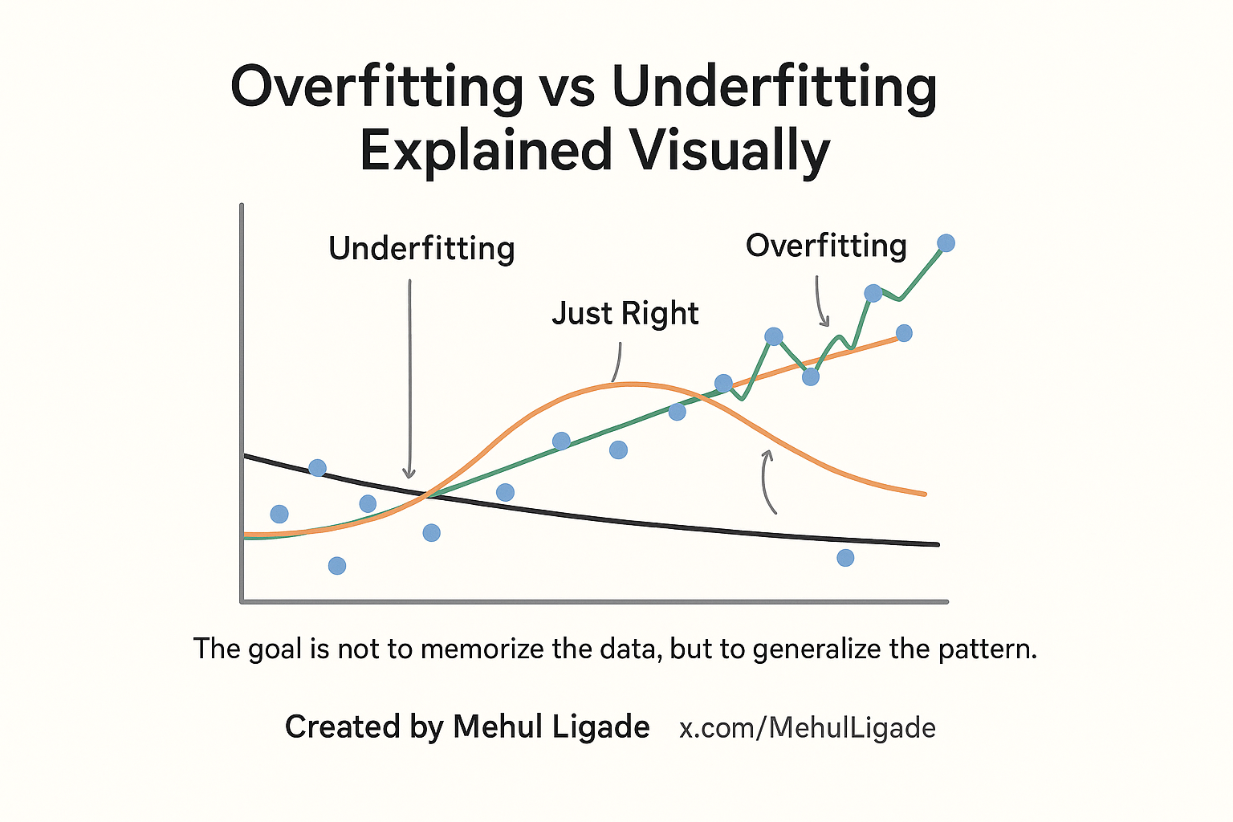
Overfitting vs. Underfitting (The Goldilocks Problem)
Underfitting (Too Simple): The model is a straight line trying to fit a curved dataset. It learns nothing useful and performs poorly on both training and testing data.
Overfitting (Too Complex): The model connects every single dot perfectly. It has "memorized" the training data but will fail completely when given new, unseen data.
The Sweet Spot: A model that captures the general trend without stressing over every tiny outlier.

Slide 4
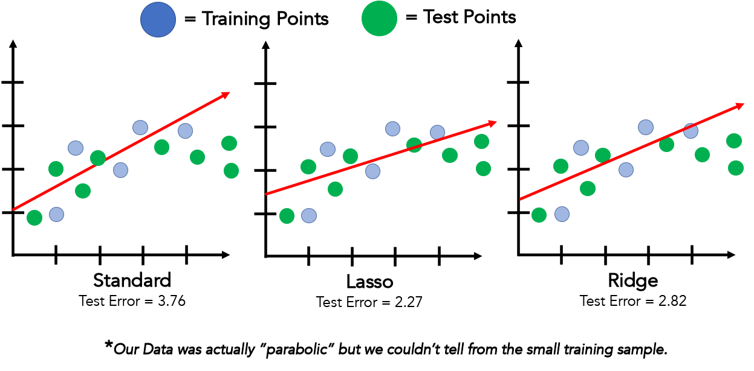
Regularization (Ridge & Lasso)
The Concept: Algorithms are greedy; they naturally want to overfit to get a "perfect" score. Regularization is a mathematical technique that gently "punishes" the model for getting too complex.
Ridge Regression (L2): Shrinks the importance of less useful columns but keeps them in the equation.
Lasso Regression (L1): The aggressive approach. It forces the importance of useless columns completely to zero, effectively deleting them and keeping the model simple.

